Slide 1

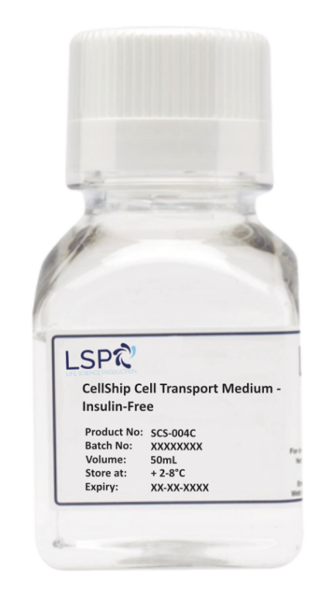
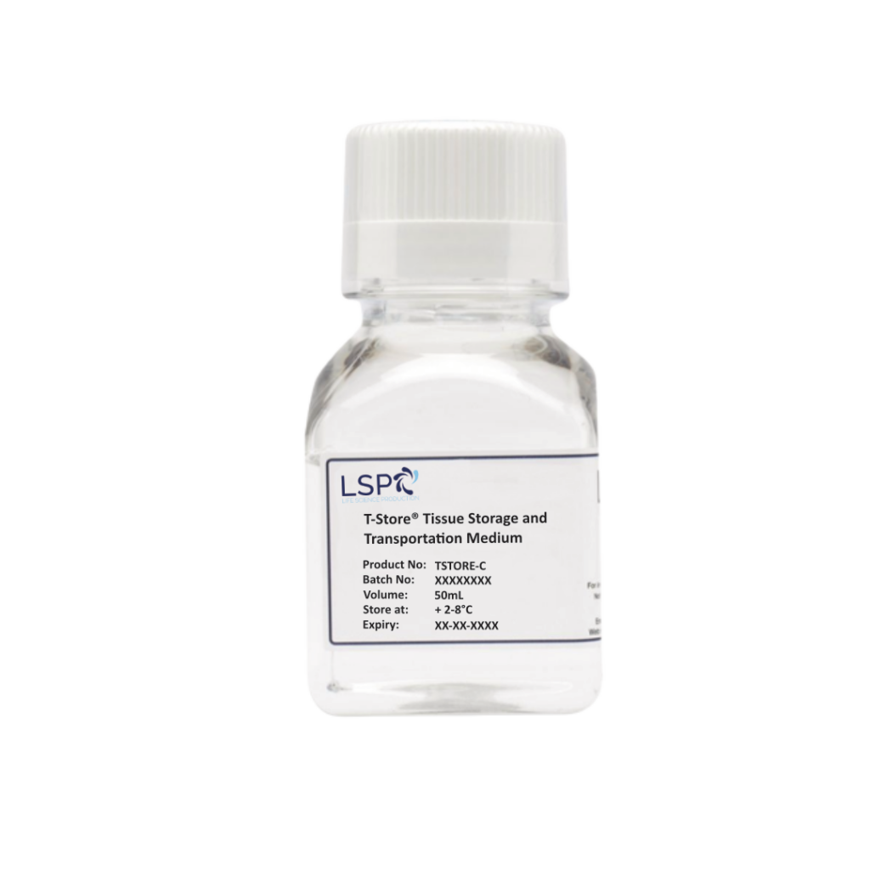

Innovative and disruptive cell transportation and storage medium
Abeer AL Hubaysh, PhD
Research Scientist
Life Science Group (LSG)
Making Pharma
26th April 2023

Slide 2
^{Outline}
Introduction
Cryopreservation
Hypothermic storage
Challenges
LSG products
T-Store®
CellShip®
Results
Impact of using CellShip® on cell recovery of different cell lines
Impact of using CellShip® on cell recovery of Jurkat cells
Impact of using CellShip® on metabolic activity and cell apoptosis of canine stem cells
Conclusion
Potential direction

Slide 3
Bio-preservation of Cellular Therapy Product
1: Cryopreservation
(Freezing)
Preservation of biological samples in a state of suspended animation at cryogenic temperature (-196°C)
Mechanism
Requires cryoprotectants e.g. DMSO, etc
Vitrification or slow freezing
2: Hypothermic storage
When cells are maintained at a temperature of 35°C or less, which causes lower activity in ATP synthesis and alter cell membrane
Mild hypothermia (32°C-35°C), moderate hypothermia (28°C- 32°C) severe hypothermia (20°C- 28°C), and chill (<20°C)

Slide 4
Hypothermic Storage Preservation
The current successes of cell pausing:
Cell type | Storage temperature | Exposure time | Storage media | %viability
Mesenchymal stem cells (hMSC). | 4ºC | 46-96h | HTS-FRS | 85%
Human embryonic stem cells. | 4ºC and 25ºC | 24-48h | DMEM/F12 with Serum | 69% and 77% respectively.
Human embryonic kidney cells (HEK293E). | 4ºC and 24ºC | 4 days | Serum-free EX-cell 293 with glutamine | 85%
Human renal cells | 4ºC | 5 days | - Renal cell culture medium | 6%
 |  |  | HTS-FRS | 75%
(Robinson et al,. 2014)
Notes:
Literatures is limited with regards to studies focusing on cell pausing of human cells and stem cells.

Slide 5
Principle Advantages of Short-term Hypothermic Preservation/Storage
Cryopreservation
Low storage temperature
Disadvantage of Cryopreservation
Formation of intracellular ice crystals.
Loss number of cells.
Loss viability and function.
Proliferation decreased.
Loss of cell surface receptors and change in cytokine production.
Requires two steps: Slow freezing and transfer to LN.
Requires days to reach the quantity of cells needed after thawing.
Expensive, freezing facility needed, labor intensive.
Advantages of Hypothermic Storage
Reduction is overall cell therapy cost.
Reduction in workload and labour of manual or automated tasks.
Avoids exposing cells to sub-zero temperatures.
Cells are recovered from storage quicker than thawing.
Reduction in processes enables commercialization.
Reduction in processes enables greater availability for patients.
Easier applications for point-of-care treatment.
Avoids the use of cytotoxic agents to the cells (i.e. DMSO)
(Robinson et al,. 2014)

Slide 6
Logistics
Dry-ice restricted aeroplane delivery by 50% of countries.
Traditional methods of delivery require complicated planning and contingencies.
The field is currently proposing drone delivery.
Notes:
Source: https://www.genengnews.com/tech-exclusives/drones-land-in-the-cell-and-gene-therapy-space/

Slide 7
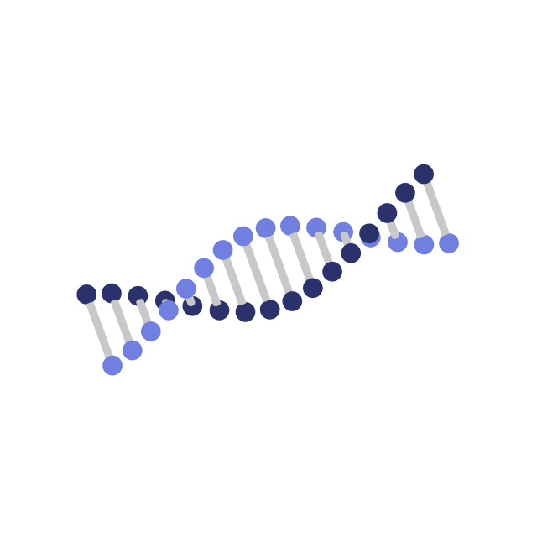
Effect of Hypothermic Storage on Cells
^{Reduced metabolism.}
^{DNA and protein damage.}
^{Apoptosis and cell death.}
To overcome cell damage, adding non-toxic CPAs should be considered to support cell preservation.
Notes:
Source: https://www.genengnews.com/tech-exclusives/drones-land-in-the-cell-and-gene-therapy-space/

Slide 8
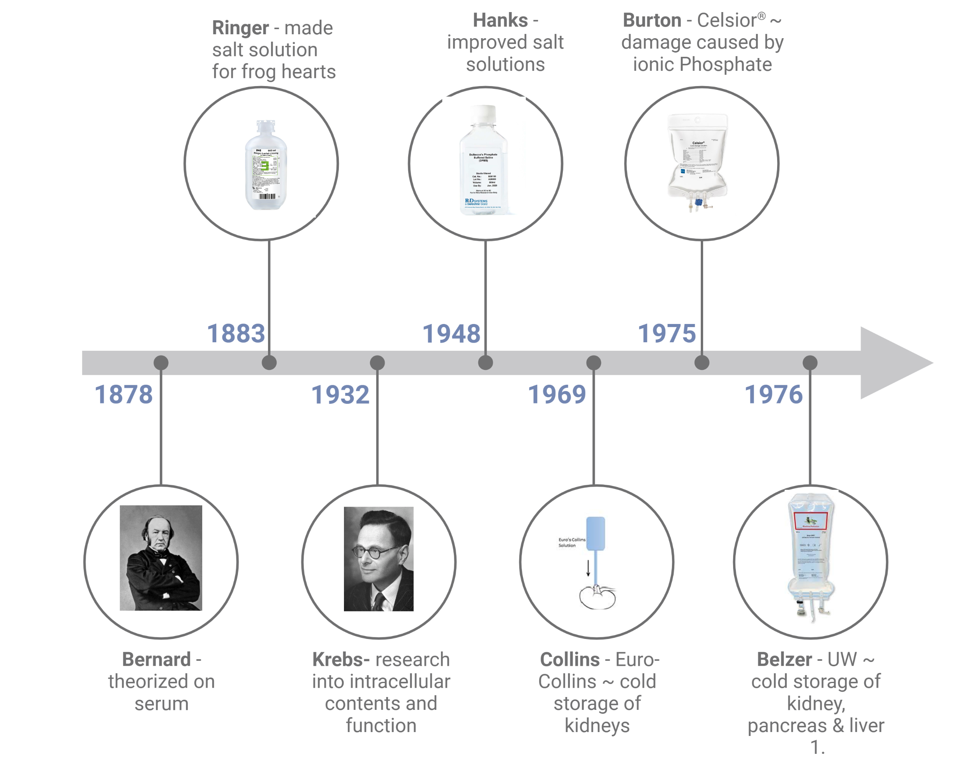
History of Physiological Solutions
Notes:
Source: https://www.genengnews.com/tech-exclusives/drones-land-in-the-cell-and-gene-therapy-space/

Slide 9
T-Store® and CellShip®
T-Store®
CellShip®
Notes:
Source: https://www.genengnews.com/tech-exclusives/drones-land-in-the-cell-and-gene-therapy-space/

Slide 10
T-Store®
Xeno-Free
Produced as a UKCA/CE-marked product
Ships at ambient temperature
T-Store®
Notes:
Source: https://www.genengnews.com/tech-exclusives/drones-land-in-the-cell-and-gene-therapy-space/

Slide 11
T-Store: Physiological Solution (Synthetic Interstitial Fluid)
What used for:
From analyses of human/animal sera and plasma and human interstitial fluid
To optimise biophysical, biochemical and physiological parameters in isolated mammalian tissues and organs
To utilise pH buffering mechanisms present in all mammalian species.
To preserve functionality under both hypothermic (4 – 15 °C).
T-Store was specifically designed for use in both Animal and Human species and to facilitate repeatable physiological and pharmacological observations thereby standardising and validating functionality under in vitro conditions.
Notes:
Source: https://www.genengnews.com/tech-exclusives/drones-land-in-the-cell-and-gene-therapy-space/

Slide 12

KTP: Product innovation and development
Drive productivity and economic growth … improve the UK economy.
Managed and operated through Innovate UK, part of UKRI (UK research & Innovation).
Support businesses to develop and realise the potential of new ideas, by utilising the UK’s world-class research base.
Facilitate knowledge exchange between industry and academia
Business partner
Academic partner
Associate
Notes:
Source: https://www.genengnews.com/tech-exclusives/drones-land-in-the-cell-and-gene-therapy-space/

Slide 13
CellShip®
Xeno-Free
Low-cost
Ships at ambient temperature
CellShip®
Notes:
Source: https://www.genengnews.com/tech-exclusives/drones-land-in-the-cell-and-gene-therapy-space/

Slide 14
CellShip®
The transport and short-term storage of mammalian cells at ambient temperature.
Animal component-free
Non-toxic
Maintain cell viability ‘on the bench’
Protect cells from shear stress associated with transport
Allow optimal cell recovery
Ease of use, (does not require washing step).
No cold chain! … Solving a problem
Notes:
Source: https://www.genengnews.com/tech-exclusives/drones-land-in-the-cell-and-gene-therapy-space/

Slide 15
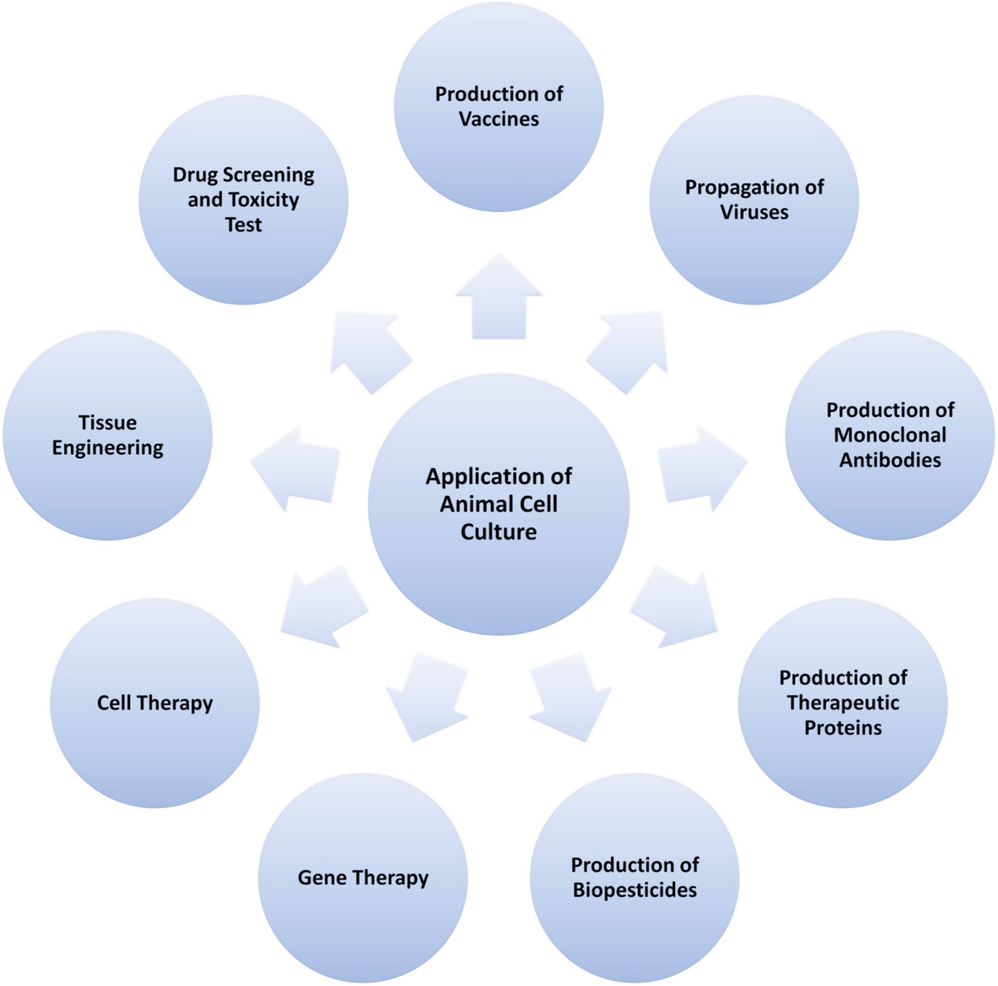
CellShip® - For Who?
Notes:
Source: https://www.genengnews.com/tech-exclusives/drones-land-in-the-cell-and-gene-therapy-space/

Slide 16
Proof of Concept on Cell Lines
Figure 1. Cell lines tested; HEK, HepG2, CHO, K562 and Jurkat. Viability was well maintained for each cell type during the 72 h transport and storage period at ambient. The fold change in cell number following recovery, correlates with cell doubling times. Error bars represent standard deviation.
Notes:
Source: https://www.genengnews.com/tech-exclusives/drones-land-in-the-cell-and-gene-therapy-space/

Slide 17
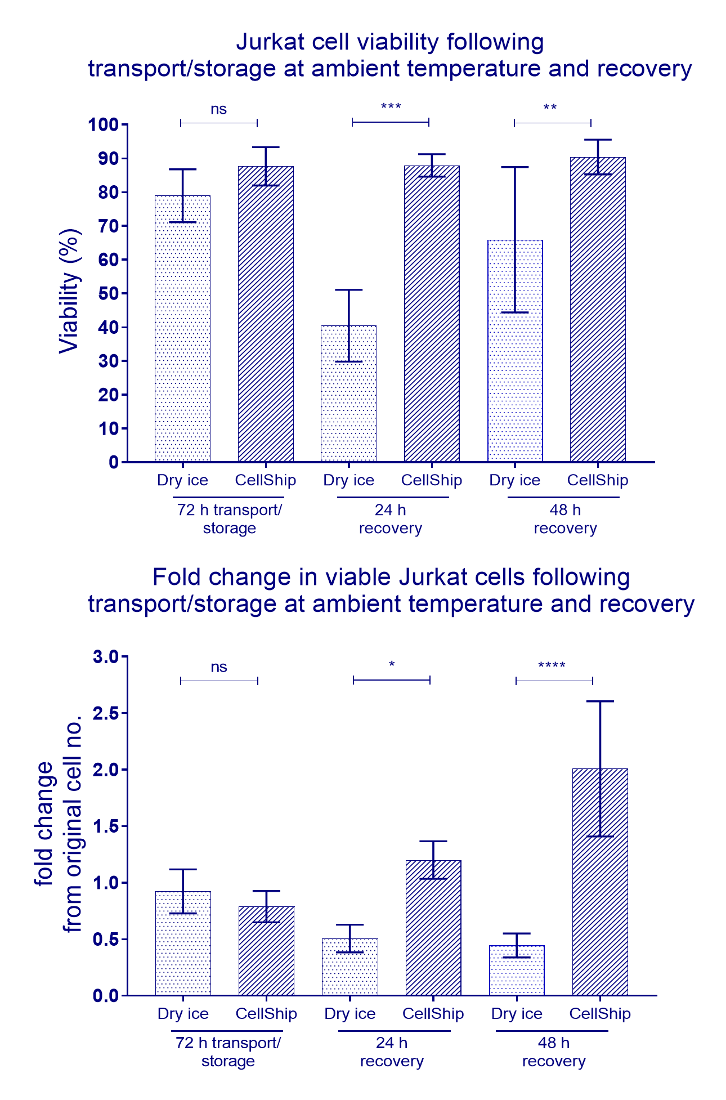
Proof of Concept on Jurkat Cell
Figure 2. Jurkat cells transported and stored using CellShip® for 72hrs. The use of CellShip® maintained viability throughout the experiment and had recovered to their pre-storage concentration by 24 h. Viability of cryopreserved Jurkat cells dropped at 24 h and had not recovered at 48 h. Cell concentration of cells recovered from cryopreservation was at 50% of the original concentration at 24 h post recovery, cell numbers and viability had recovered by 96 h. Mean fold change ± standard deviation (n = 3 – 6). A one-way ANOVA was used for statistical analysis *p < 0.05, **p < 0.01, ***p < 0.001, ****p < 0.0001.
Notes:
Source: https://www.genengnews.com/tech-exclusives/drones-land-in-the-cell-and-gene-therapy-space/

Slide 18
Proof of Concept on Jurkat Cell
Figure 3. Jurkat cells transported and stored using CellShip® for 96hrs. Viability was well maintained during the 96 h transport and storage period and cell numbers had returned to the pre-transport and storage concentration at 24 h post recovery. Error bars represent standard deviation (n=3).
Notes:
Source: https://www.genengnews.com/tech-exclusives/drones-land-in-the-cell-and-gene-therapy-space/

Slide 19
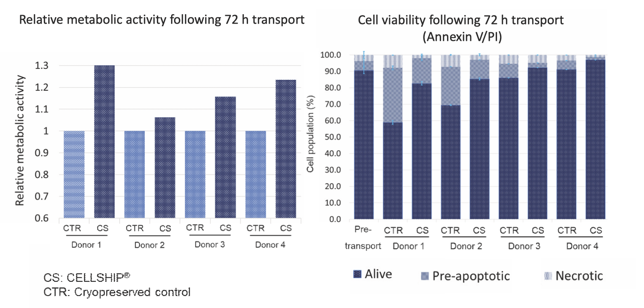
Proof of Concept on Canine Stem Cells
A
B
Figure 4. Metabolic activity and cell apoptosis following 72hrs of storage in CellShip®. (A) Metabolic activity was either slightly higher or comparable to the controls. (B) Cells transported in CellShip® showed a lower proportion of pre-apoptotic cells than the cryopreserved cells.
Notes:
Source: https://www.genengnews.com/tech-exclusives/drones-land-in-the-cell-and-gene-therapy-space/

Slide 20
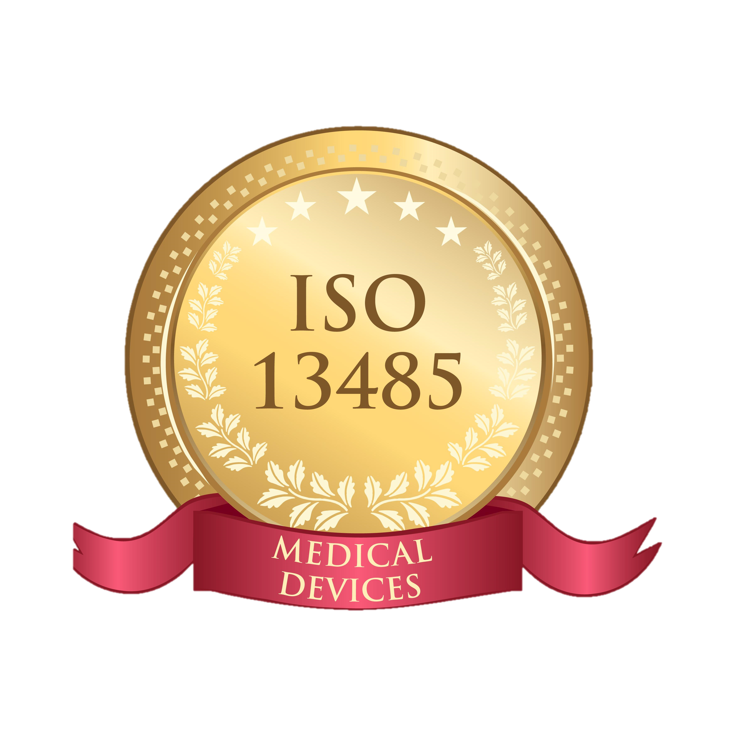
Regulatory Requirements
ISO 13485 (medical devices)
Meeting the regulatory requirements will be essential in order to access the Advanced Therapy Medicinal Product (ATMP) market
CE marking
LSG has met the ISO 13485 standards regarding documentation, auditing and design processes, that would be unnecessarily stringent in other development contexts
A medical device is "Any instrument, apparatus, appliance, software, implant, reagent, material or other article intended by the manufacturer to be used, alone or in combination, for human beings for one or more specific medical purpose”.
Notes:
Source: https://www.genengnews.com/tech-exclusives/drones-land-in-the-cell-and-gene-therapy-space/

Slide 21
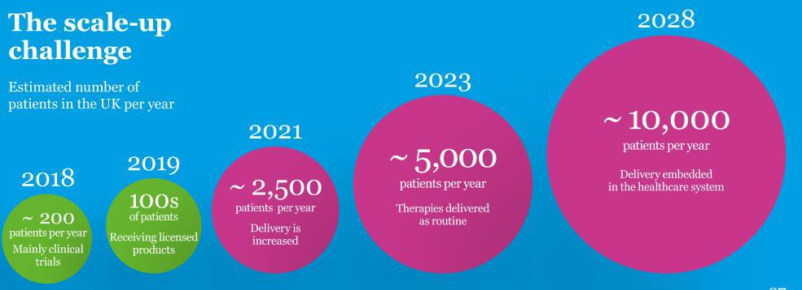
Advanced Therapeutic Medicinal Products
Notes:
Source: https://www.genengnews.com/tech-exclusives/drones-land-in-the-cell-and-gene-therapy-space/

Slide 22
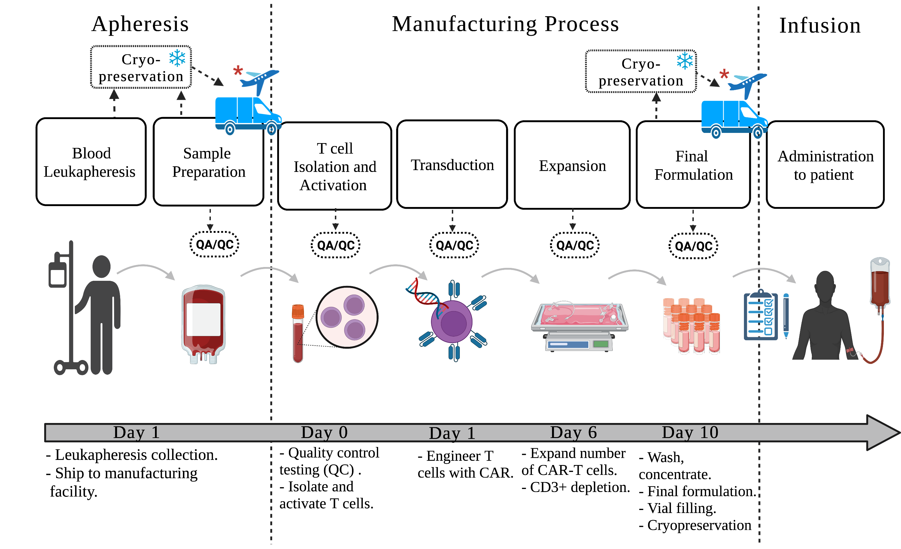
CAR-T Cell Manufacturing
Notes:
Source: https://www.genengnews.com/tech-exclusives/drones-land-in-the-cell-and-gene-therapy-space/

Slide 23
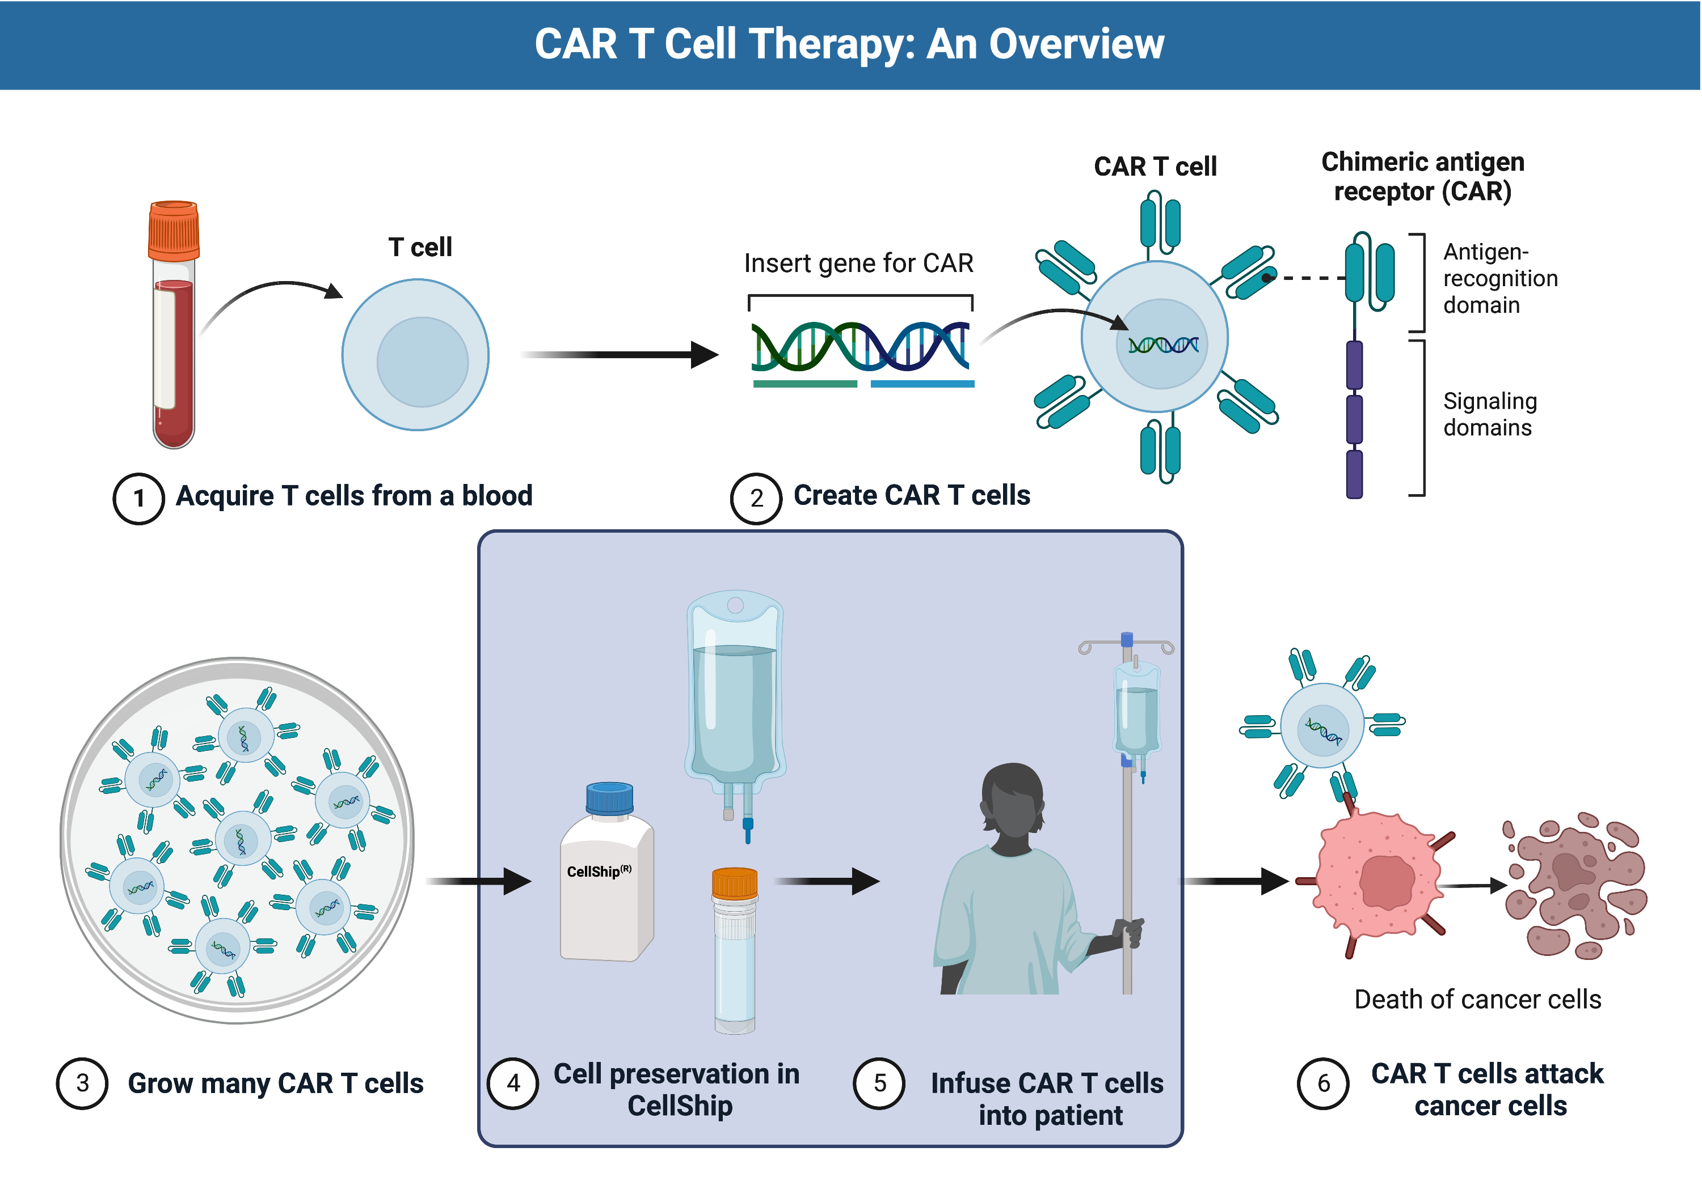
Potential Direction: The Use of CellShip®
Notes:
Source: https://www.genengnews.com/tech-exclusives/drones-land-in-the-cell-and-gene-therapy-space/

Slide 24
References
Marek, N.T., Piekarska, K., Filipowicz, N., Piotrowski, A., Gucwa, M., Vogt, K,. Sawitzki, Birgit., Siebert, J., Trzonkowski, P 2017, ‘ Mild hypothermia provides Treg stability’. Scientific reports, vol. 7, no. 11915.
Robinson, N.J., Picken, A., Coopman, K 2014, ‘Low temperature cell pausing: an alternative short-term preservation method for use in cell therapies including stem cell application’. Biotechnology letters, vol.36, no.2, pp.201-209.
Thomas A. Mace, Lingwen Zhong, Kathleen M. Kokolus, Elizabeth A. Repasky 2012, ’ Effector CD8 T cell IFN-γ production and cytotoxicity are enhanced by mild hyperthermia’. International Journal of Hyperthermia, vol. 28, no.1, pp.9-18.
Beilin, Shavit, Razumovsky, Z., Wolloch, Bessler 1998, ‘Effects of Mild Perioperative Hypothermia on Cellular Immune Responses’. Anesthesiology, vol. 89, pp.113-1140.

Slide 25
Acknowledgements

Slide 26

Thank You
Abeer AL Hubaysh, PhD
Web: www.lifesciencegroup.co.uk
Email: abeeralhubaysh@lifesciencegroup.co.uk
© LSG 2023

